Slide 1
Basic Command Line in Linux

Slide 2
Agenda:
GUI vs CLI
Basic Command Line in Linux
ls
pwd
cd
mkdir
chmod
cat
rm
mv

Slide 3
GUI vs CLI
Graphical User Interface. GUI permits users to use the graphics to interact with an operating system. In graphical user interface, menus are provided such as : windows, scrollbars, buttons, wizards, painting pictures, alternative icons etc. It’s intuitive, simple to find out and reduces psychological feature load.
Command Line Interface. CLI permits users to put in writing commands associate degree exceedingly in terminal or console window to interact with an operating system.
Notes:
https://byjus.com/gate/difference-between-cli-and-gui/#:~:text=GUI%20lets%20a%20user%20interact,the%20help%20of%20various%20commands.

Slide 4

ls - command
The ls command is the most commonly used command in linux, and the ls command is an acronym for list.
Ls is used to print a list of current directories.
Command Format : ls [OPTION]
Notes:
https://byjus.com/gate/difference-between-cli-and-gui/#:~:text=GUI%20lets%20a%20user%20interact,the%20help%20of%20various%20commands.

Slide 5
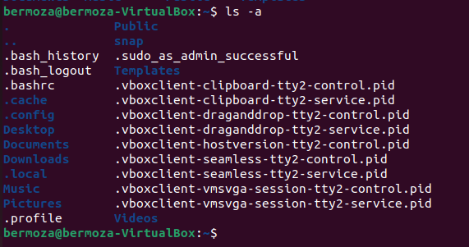
ls [options]
list hidden files/directories: ls -a
Notes:
https://byjus.com/gate/difference-between-cli-and-gui/#:~:text=GUI%20lets%20a%20user%20interact,the%20help%20of%20various%20commands.

Slide 6

ls [options]
display files/directories in reverse order: ls -r
Notes:
https://byjus.com/gate/difference-between-cli-and-gui/#:~:text=GUI%20lets%20a%20user%20interact,the%20help%20of%20various%20commands.

Slide 7
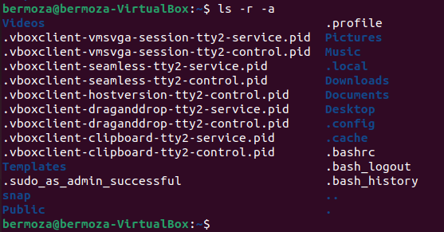
ls [options]
list hidden files/directories & display in reverse order:
ls -r -a

Slide 8
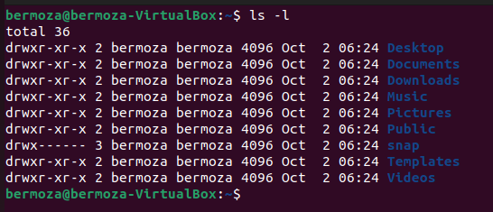
ls [options]
Display detailed information about files and directories:
ls –l

Slide 9
ls [options]
1. The first character = ‘-‘, which means it’s a file ‘d’, which means it’s a directory.

Slide 10
ls [options]
2. The next nine characters = (rw-r–r–) show the security

Slide 11
ls [options]
3. owner of the file.
4. group owner of the file.

Slide 12
ls [options]
5. size of the file in bytes.
6. date and time the file was last modified.

Slide 13
ls [options]
7. Last Column = File_name or Directory_name.

Slide 14

pwd - command
Print the full filename of the current working directory.
The pwd command is an acronym for Print Working Directory.
**Path
Command Format: pwd

Slide 15
cd - command
The cd command can be said to be the most basic command
statement in Linux.
The cd command is an abbreviation of change directory, which
switches the current directory to the specified directory.
File & Directory Commands
To navigate into the root directory, use "cd /"
To navigate to your home directory, use "cd"
To navigate up one directory level, use "cd .."
To navigate to the previous directory (or back), use "cd -"

Slide 16
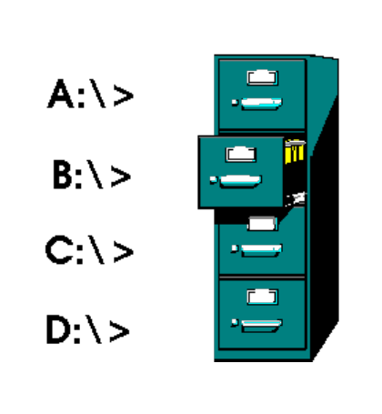
Linux vs Windows File Structure

Slide 17
cd - command
File & Directory Commands
To navigate into the root directory, use "cd /"
To navigate to your home directory, use "cd"
To navigate up one directory level, use "cd .."
To navigate to the previous directory (or back), use "cd -"

Slide 18
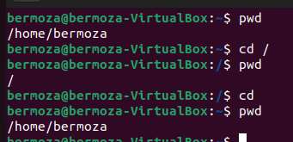
cd - command
To navigate into the root directory, use "cd /"
To navigate to your home directory, use "cd"

Slide 19
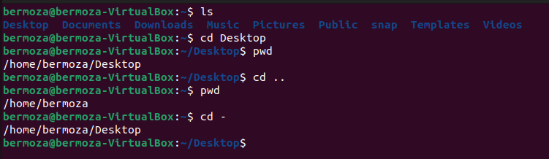
cd - command
To navigate up one directory level, use "cd .."
To navigate to the previous directory (or back), use "cd -"

Slide 20
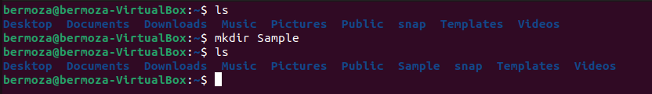
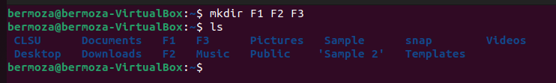
mkdir command
The command that allows you to create directories
Command Format: mkdir [options] directory

Slide 21
mkdir command
The command that allows you to create directories
Command Format: mkdir [options] directory
-m --mode Set permissions
-p --p If some of the directories in the path do not exist yet, this option will automatically create directories that do not yet exist, that is, multiple directories can be created at one time.
-v --verbose Each time a new directory is created, information is displayed.

Slide 22
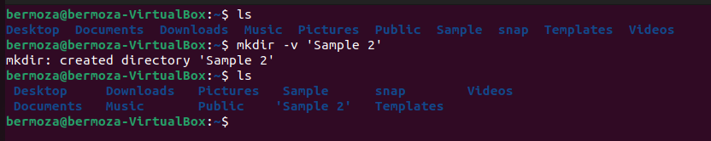
mkdir command
-v --verbose Each time a new directory is created, information is displayed.

Slide 23
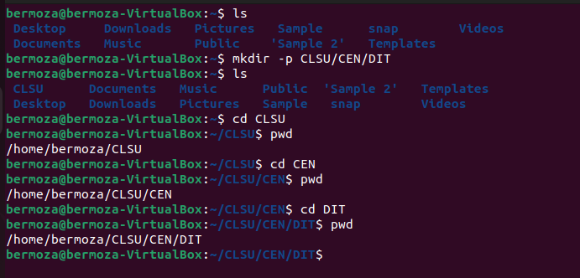
mkdir command
-p --p If some of the directories in the path do not exist yet, this option will automatically create directories that do not yet exist, that is, multiple directories can be created at one time.

Slide 24
mkdir command
Linux is a multi-user operating system, so it has security to prevent people from accessing each other’s confidential files.
mkdir -m <mode> <fileName>
Set Permissions/Class:
Modes:
U – User
G – Group
O - Others
4 – Read
2 – Write
1 – Execute

Slide 25
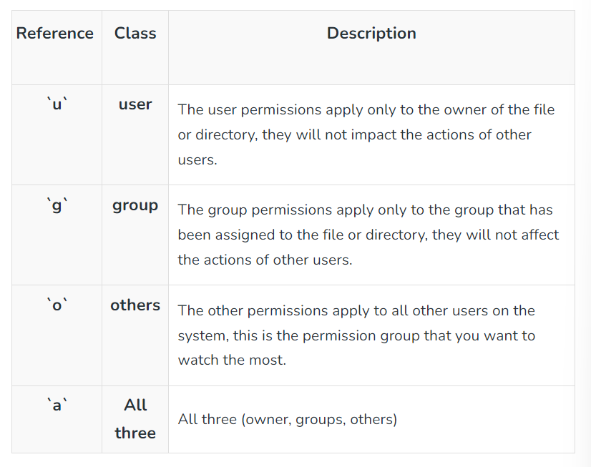
File Permission
Set Permissions/
class:
U – User
G – Group
O - Others

Slide 26
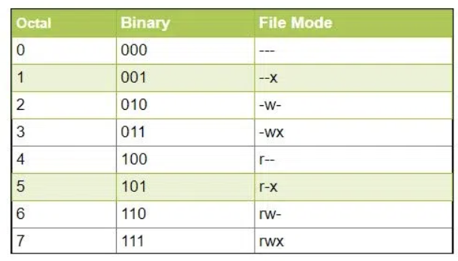
File Permission
Modes:
4 – Read
2 – Write
1 – Execute

Slide 27
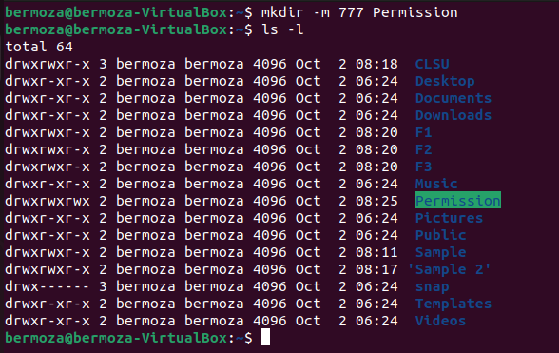
mkdir command
$ mkdir -m <mode> <fileName>

Slide 28
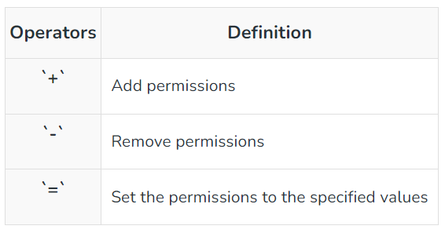
chmod command
The command you use to change the security permissions on files is called “chmod“, which stands for “change mode”
chmod class operator permission file

Slide 29





Slide 30
File Permission
Multiple permission at once
$chmod ugo-rwx filename.txt
Multiple permission at once
$chmod ug+rw, o-x filename.txt
$chmod ug=rx, o+r filename.txt

Slide 31
File Permission
$chmod ugo+rwx [file_name]
$chmod 777 [file_name]
$chmod u=r,g=wx,o=rx [file_name]
$chmod 435 [file_name]
$chmod 775 [file_name]
$chmod ug+rwx,o=rx [file_name]

Slide 32
cat - command
The cat command is an abbreviation for concatenate.
concatenate files and print on the standard output.
Command Format cat [filename]
cat file1.txt

Slide 33
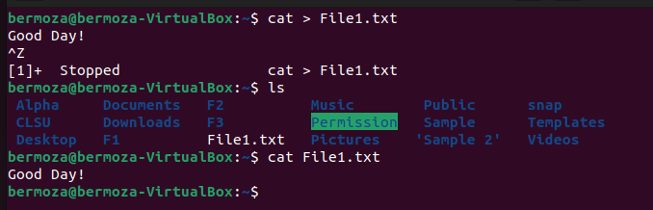
cat - command
create file using cat command
cat > [name-of-new-file]
cat > file1.txt

Slide 34
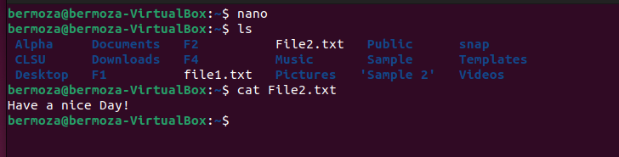
create file using nano
nano [filename]

Slide 35
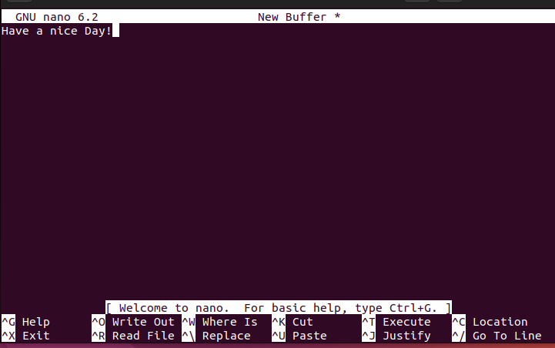
create file using nano
nano [filename]
Ctrl x – Exit
Y

Slide 36
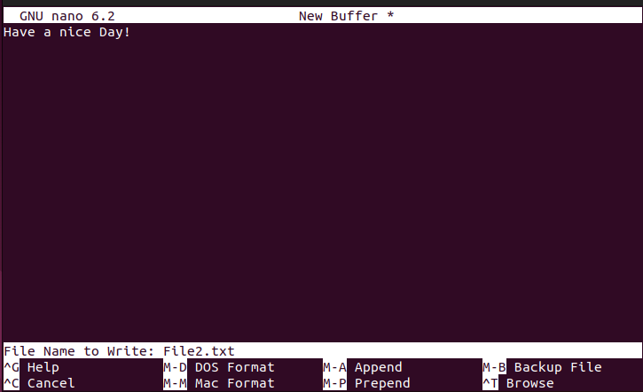
create file using nano
nano [filename]

Slide 37


cat - command
display multiple files using cat
cat [filename] [filename] ...
cat file1.txt file2.txt
display contents of file with line numbers
cat -n [filename]
cat -n file1.txt

Slide 38

cat - command
copy the contents of one file to another file
cat [filename-whose-contents-is-to-be-copied] >
[destination-filename]
cat file1.txt > file3.txt

Slide 39
rm - command
rm is a commonly used command. The function of this command is to delete one or more files or directories in a directory.
Command Format: rm [options] file or directory
-f --force Ignore nonexistent files and never give prompts
-i --interactive Make an interactive deletion
-d --directory Remove the directory
-v --verbose Detailed display of the steps performed

Slide 40
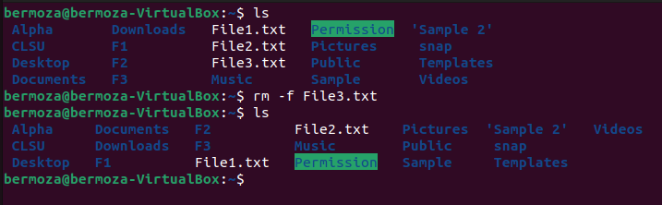
rm -f command
-f --force Ignore nonexistent files and never give prompts

Slide 41
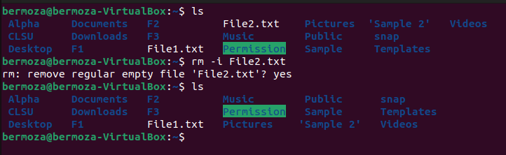
rm -i command
-i --interactive Make an interactive deletion

Slide 42
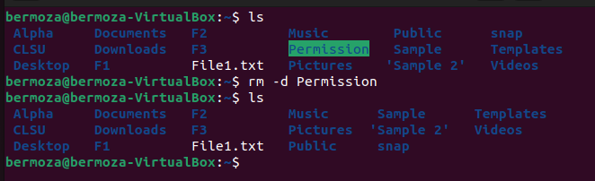
rm -d command
-d --directory Remove the empty directory

Slide 43
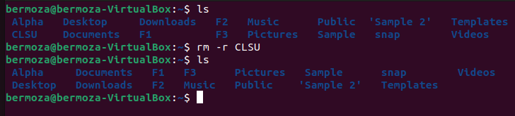
rm -r command
-r --directory Remove the not empty directory

Slide 44
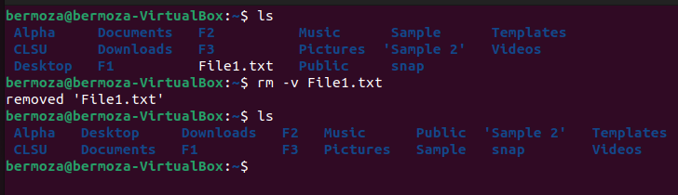
rm -v command
-v --verbose Detailed display of the steps performed

Slide 45
mv - command
The mv command's function is used to move files or change file
Names
Command Format:
• Rename: mv [filename] [new_filename]
• move a file to a new location
mv [filename] [dest-dir]
mv fullnames.txt /home/himanshu/Downloads

Slide 46
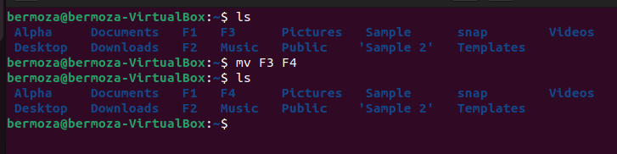
mv - command
Rename: mv [filename] [new_filename]

Slide 47
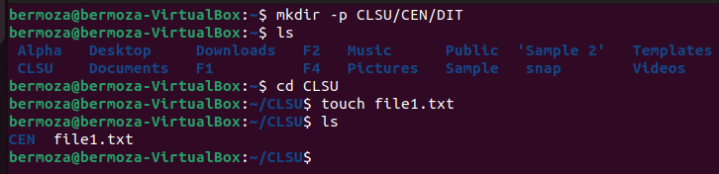
mv - command
move a file to a new location
mv [filename] [dest-dir]
mv fullnames.txt /home/himanshu/Downloads

Slide 48
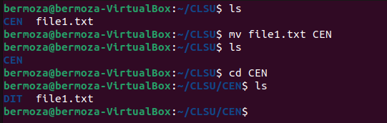
mv - command
move a file to a new location
mv [filename] [dest-dir]
mv file1.txt CEN

Slide 49
Thank you!

Slide 50
Why learn CLI?
Commands are flexible and offer more options
Perform more with just one command.
Work on multiple files at a time
CLSI is fast
Notes:
https://byjus.com/gate/difference-between-cli-and-gui/#:~:text=GUI%20lets%20a%20user%20interact,the%20help%20of%20various%20commands.

